Slide 1

# m.O.O.S.E. #

Slide 2
# m.O.O.S.E. #
FUNCTIONAL
TASKING
AI
CARGO
WRAPPER
CORE
DCS WORLD API

Slide 3
# m.O.O.S.E. #
FUNCTIONAL
TASKING
AI
CARGO
WRAPPER
CORE
DCS WORLD API

Slide 4
# m.O.O.S.E. #
FUNCTIONAL
TASKING
AI
CARGO
WRAPPER
CORE
DCS WORLD API

Slide 5
# m.O.O.S.E. #
FUNCTIONAL
TASKING
AI
CARGO
WRAPPER
CORE
DCS WORLD API

Slide 6
# m.O.O.S.E. #
FUNCTIONAL
TASKING
AI
CARGO
WRAPPER
CORE
DCS WORLD API

Slide 7
# m.O.O.S.E. #
FUNCTIONAL
TASKING
AI
CARGO
WRAPPER
CORE
DCS WORLD API

Slide 8
# m.O.O.S.E. #
FUNCTIONAL
TASKING
AI
CARGO
WRAPPER
CORE
DCS WORLD API

Slide 9
# m.O.O.S.E. #
FUNCTIONAL
TASKING
AI
CARGO
WRAPPER
CORE
DCS WORLD API

Slide 10
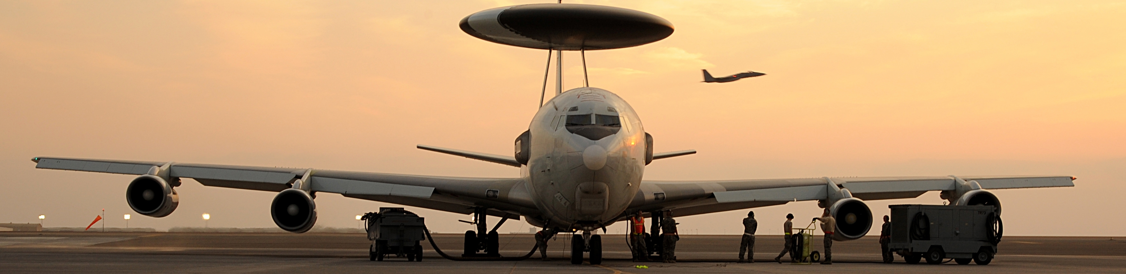
ai - air to air (A2A) - dispatching

Slide 11
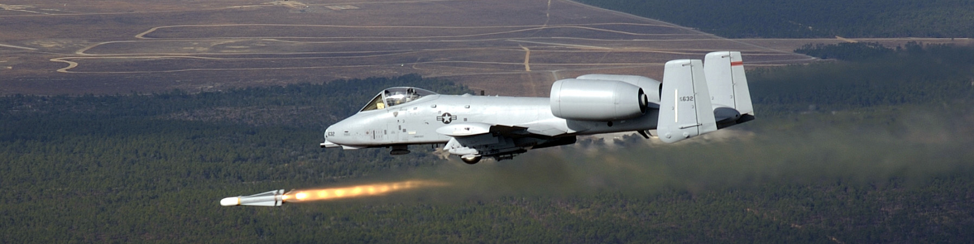
ai - air to ground (A2G) - dispatching

Slide 12
ai - A2G - Patrol

Slide 13
ai - A2G - engage

Slide 14
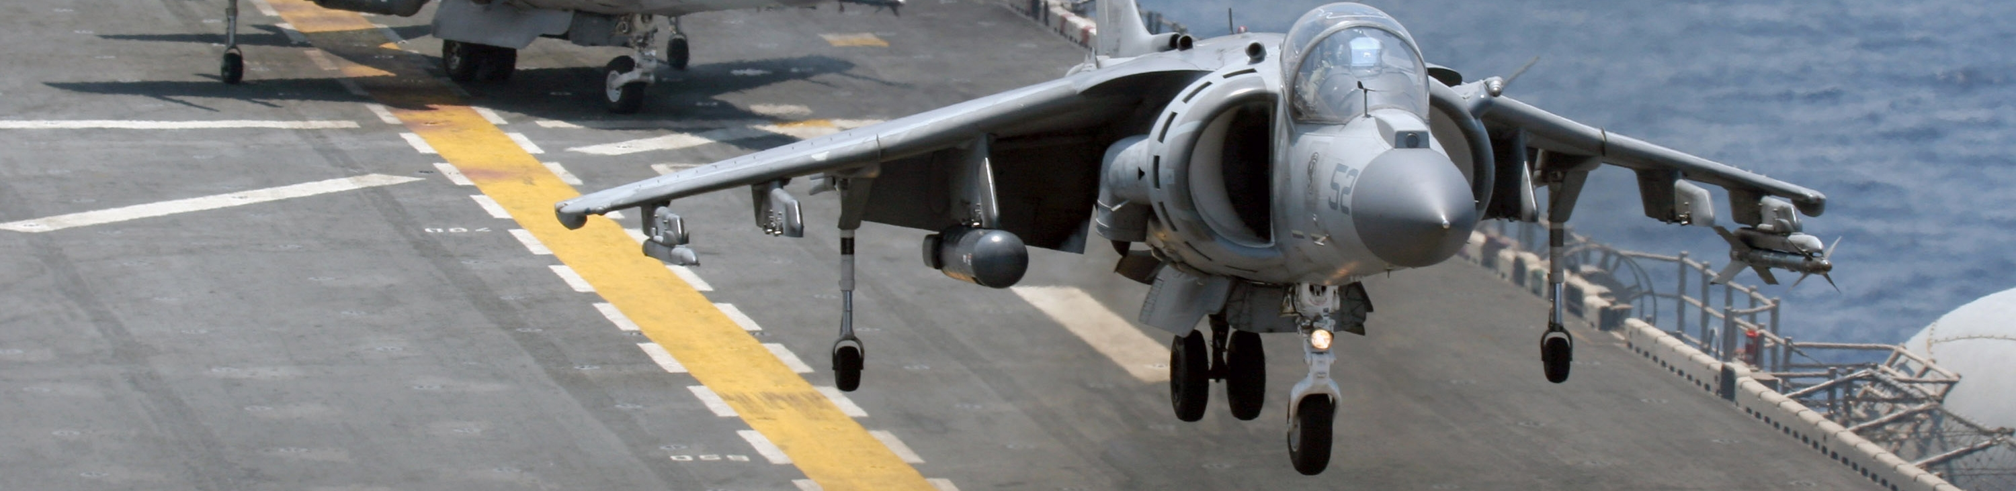
ai - A2A - patrol

Slide 15
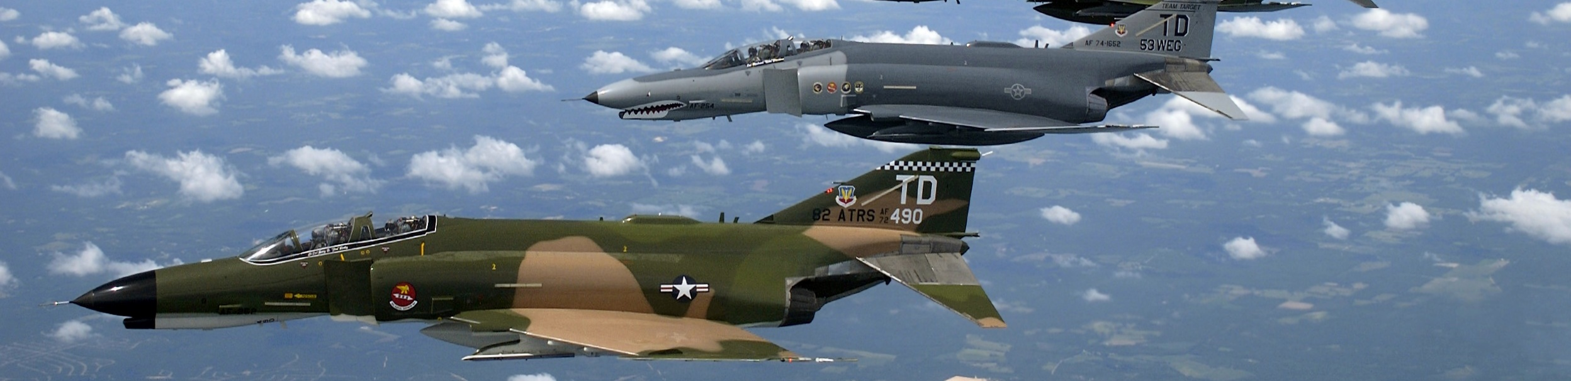
ai - A2A - combat air patrol (cap)

Slide 16
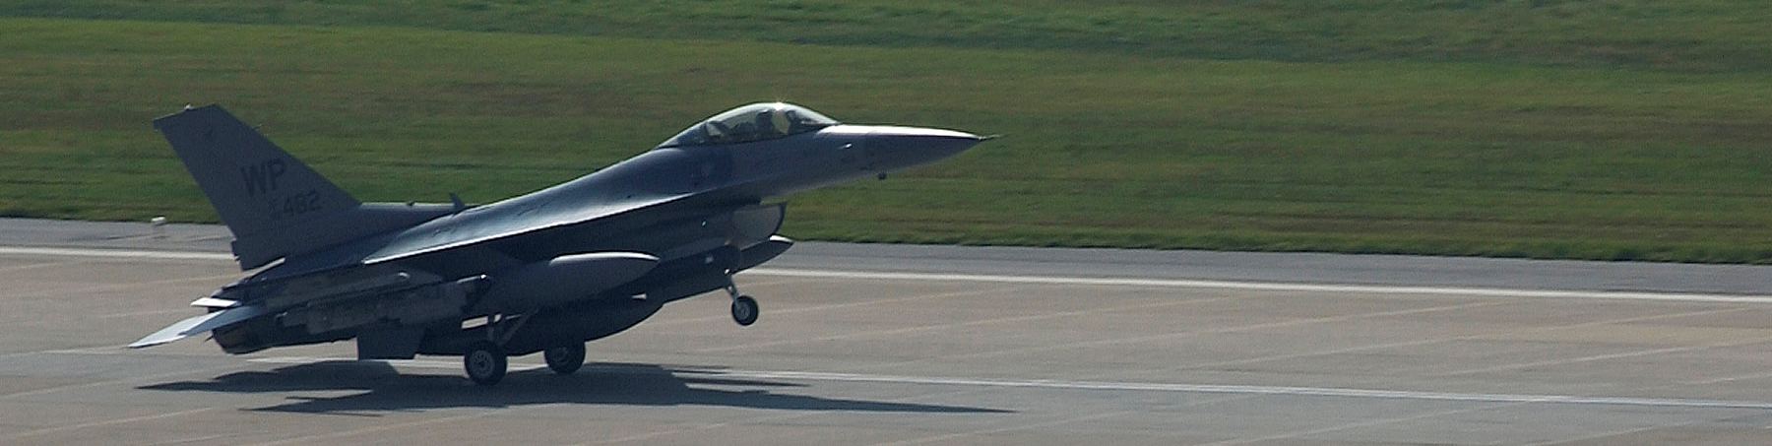
ai - A2A - ground control intercept (gci)

Slide 17

ai - A2G - close air support (cas)

Slide 18
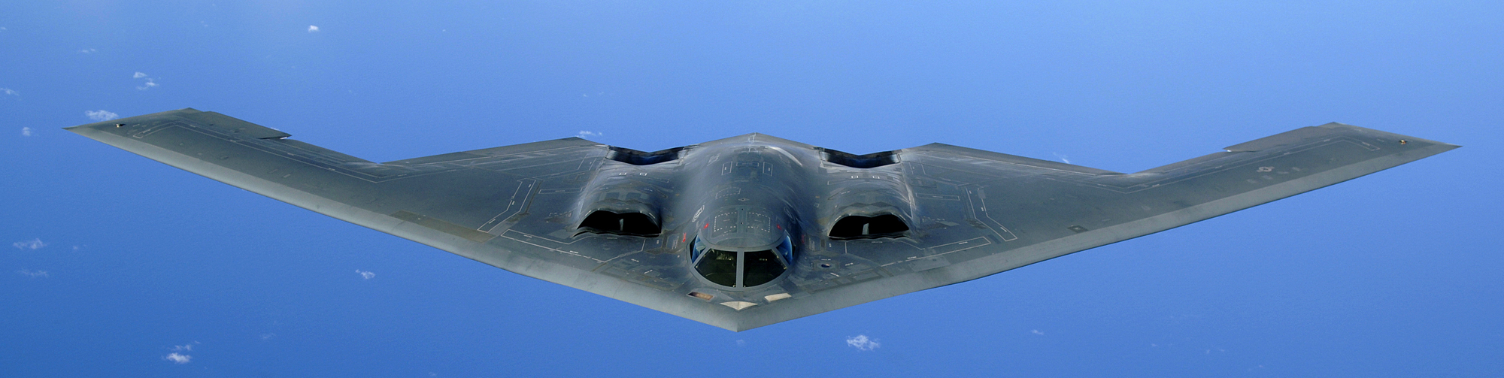
ai - A2G - battlefield air interdiction (bai)

Slide 19

ai - balancing

Slide 20
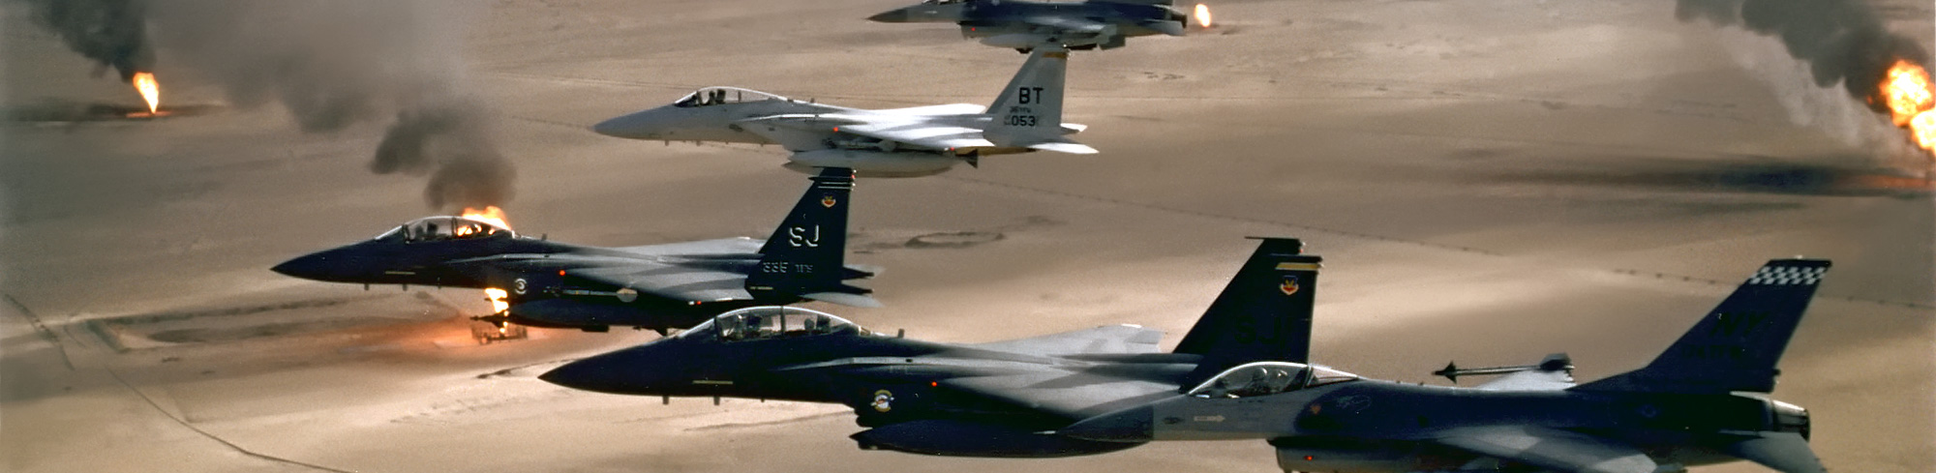
ai - large formations

Slide 21
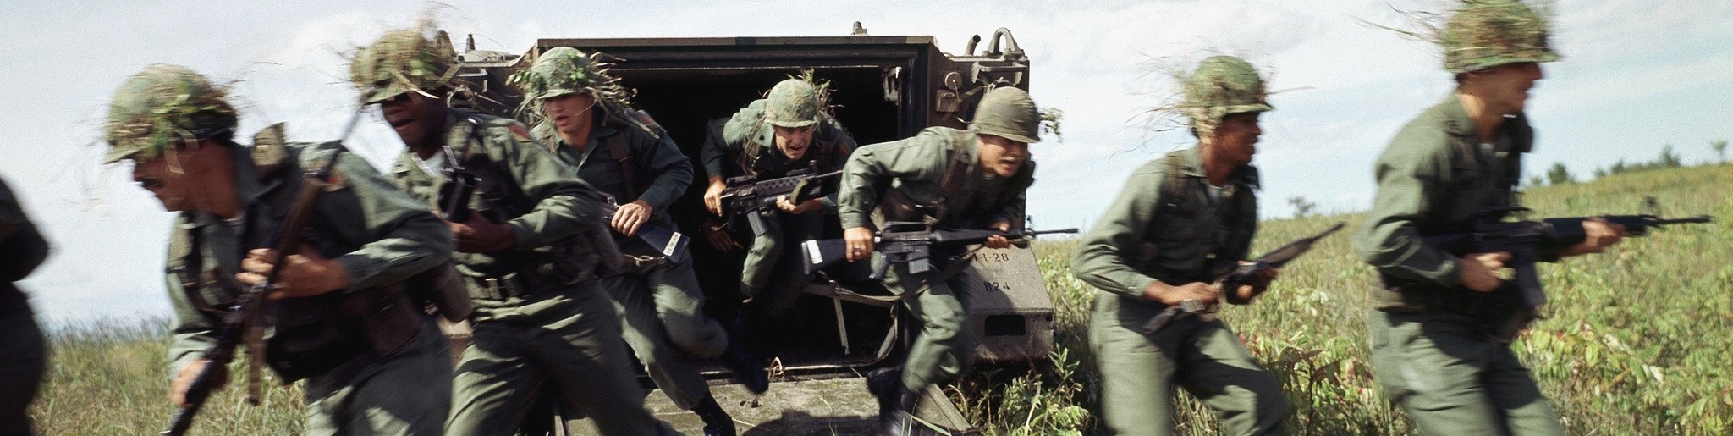
ai - cargo dispatching for apc

Slide 22
ai - cargo dispatching

Slide 23
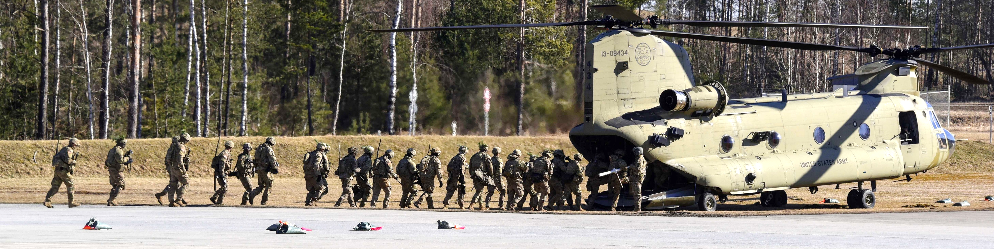
ai - cargo dispatching for helicopters

Slide 24
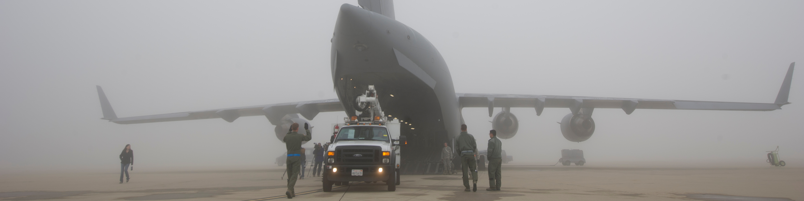
ai - cargo dispatching for airplanes

Slide 25
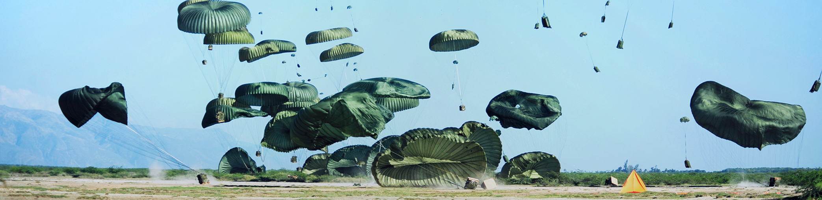
cargo

Slide 26
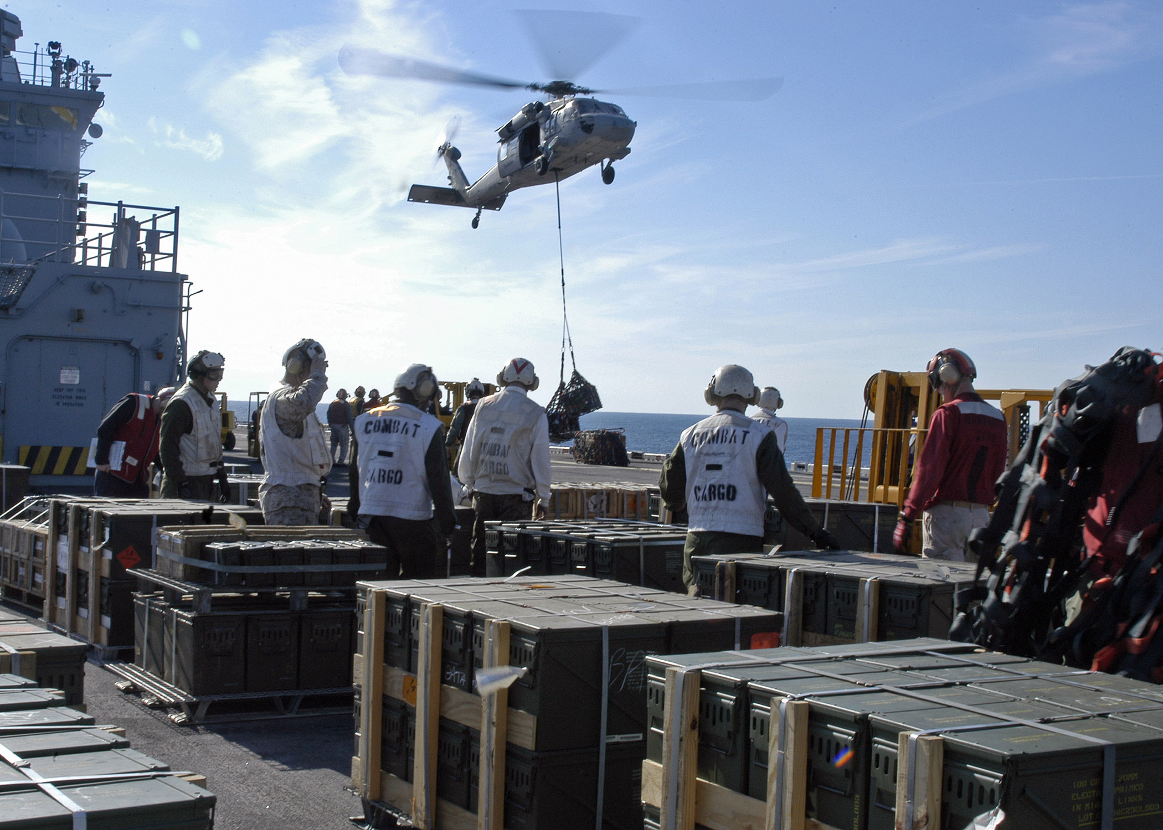
carge - crates

Slide 27
cargo - slingload

Slide 28
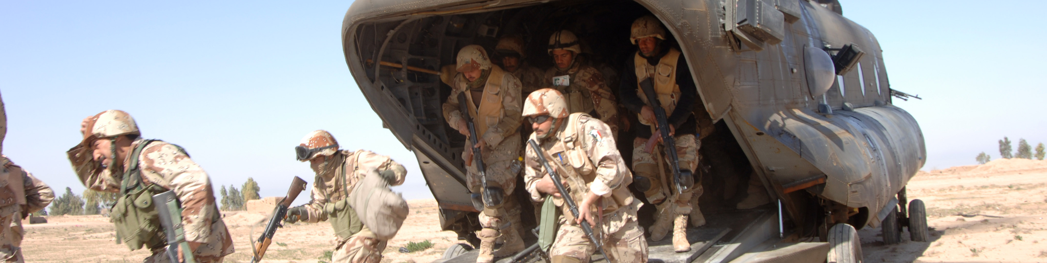
cargo - groups

Slide 29
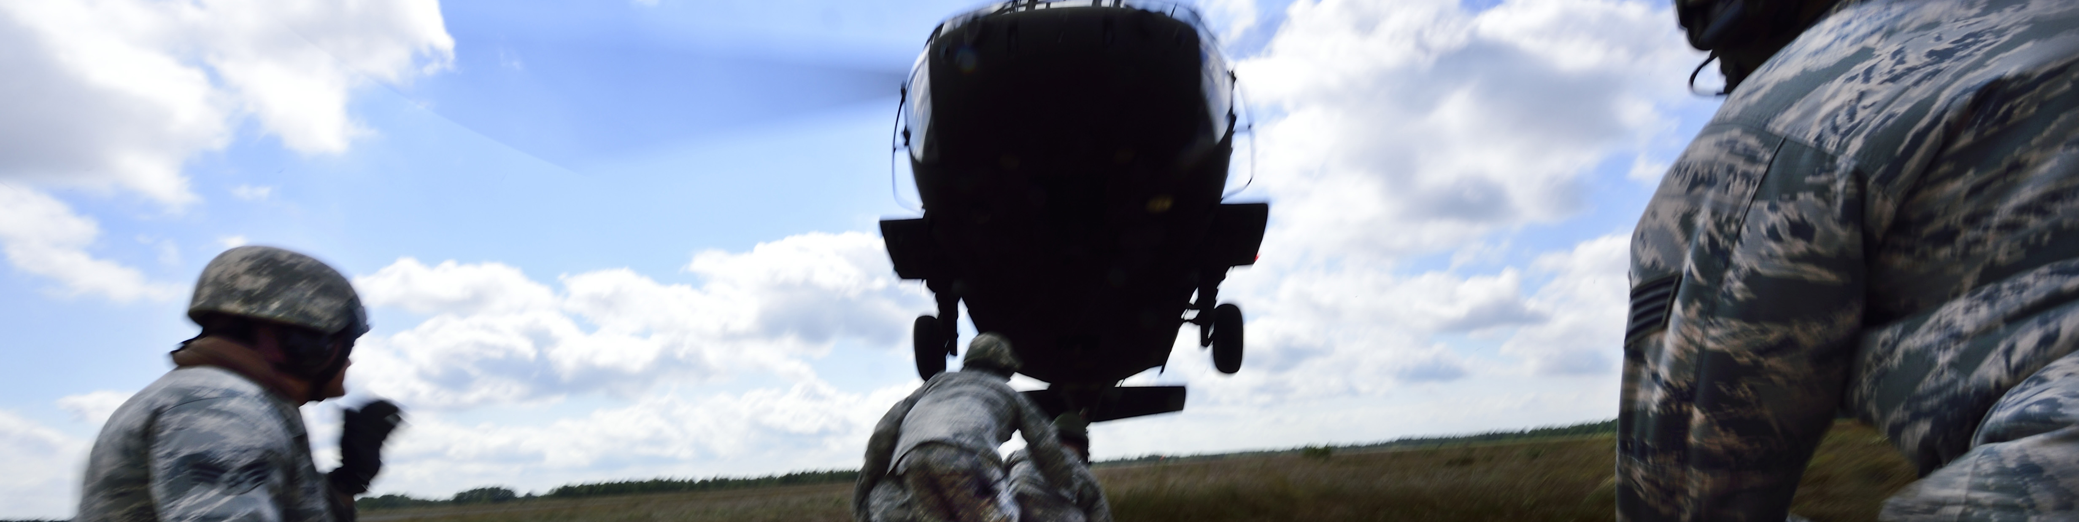
cargo - units

Slide 30
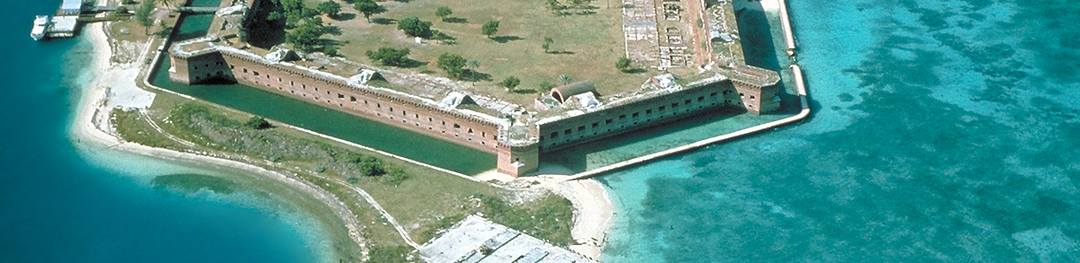
core - base

Slide 31

core - database

Slide 32
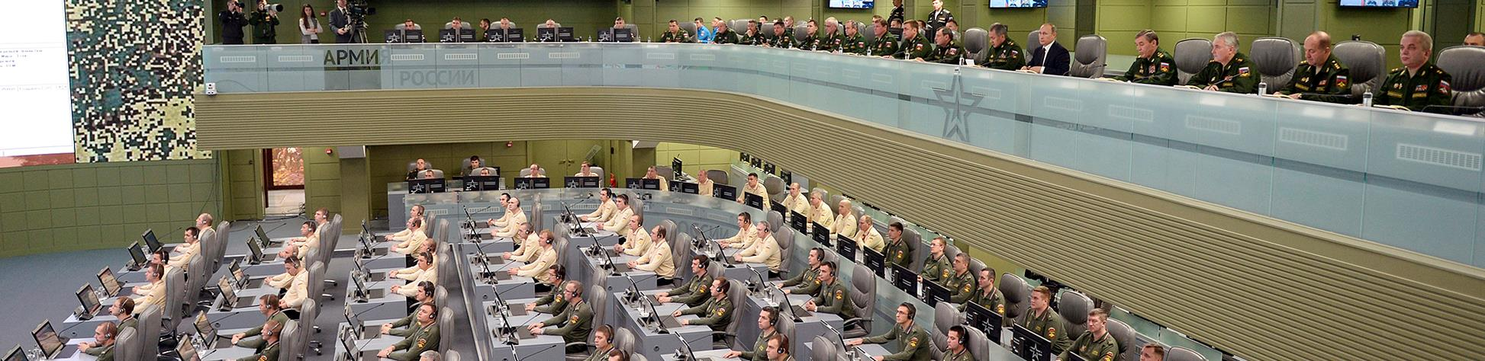
core - event

Slide 33
core - finite state machine

Slide 34
core - goal

Slide 35
core - menu

Slide 36
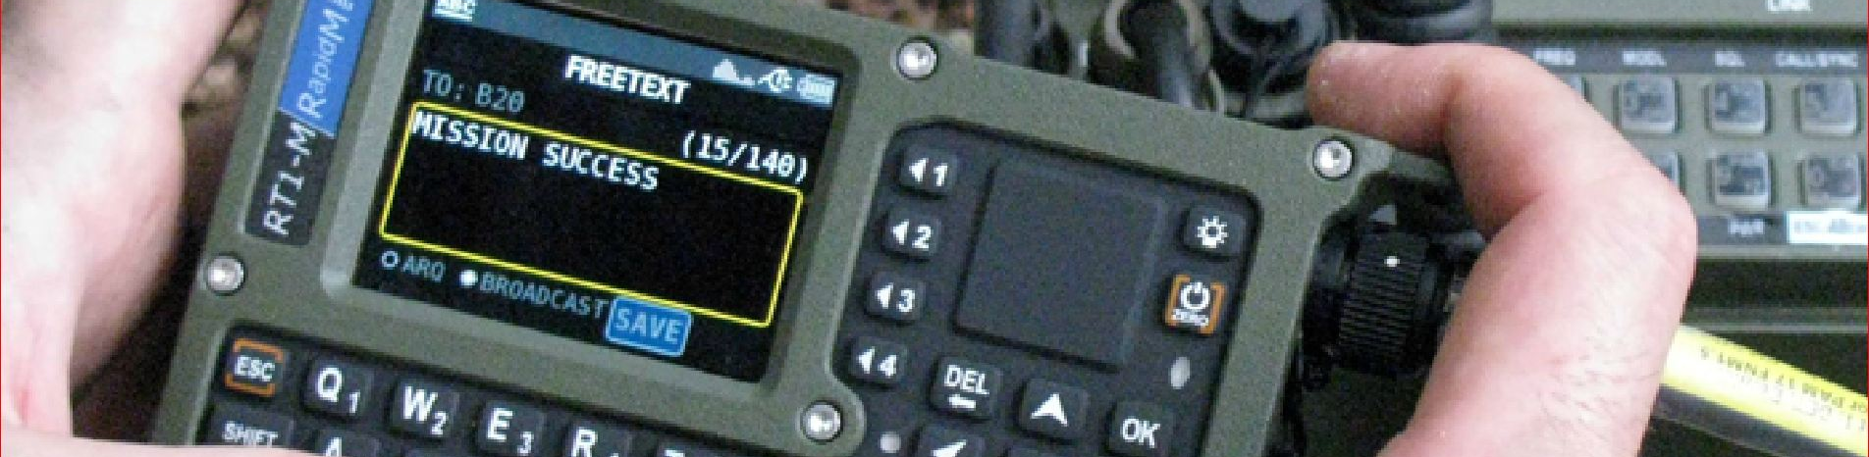
core - message

Slide 37

core - coordinate

Slide 38
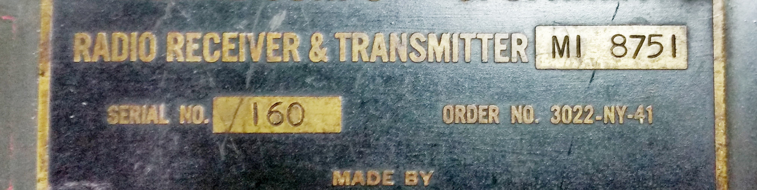
core - radio

Slide 39
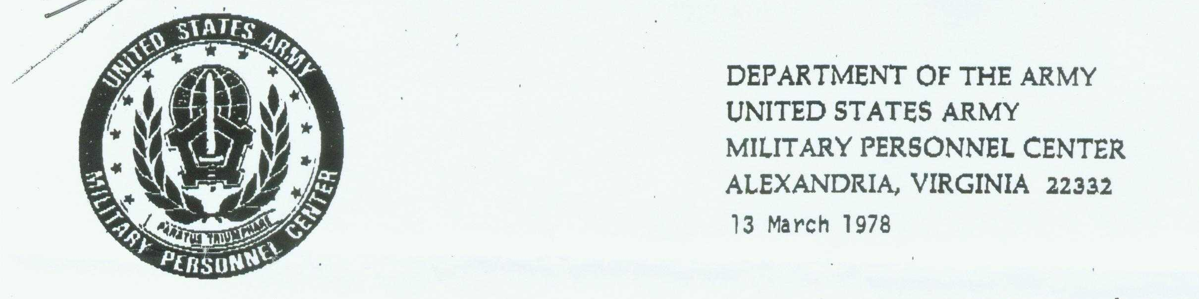
core - report

Slide 40

core - schedule dispatcher

Slide 41
core - scheduler

Slide 42
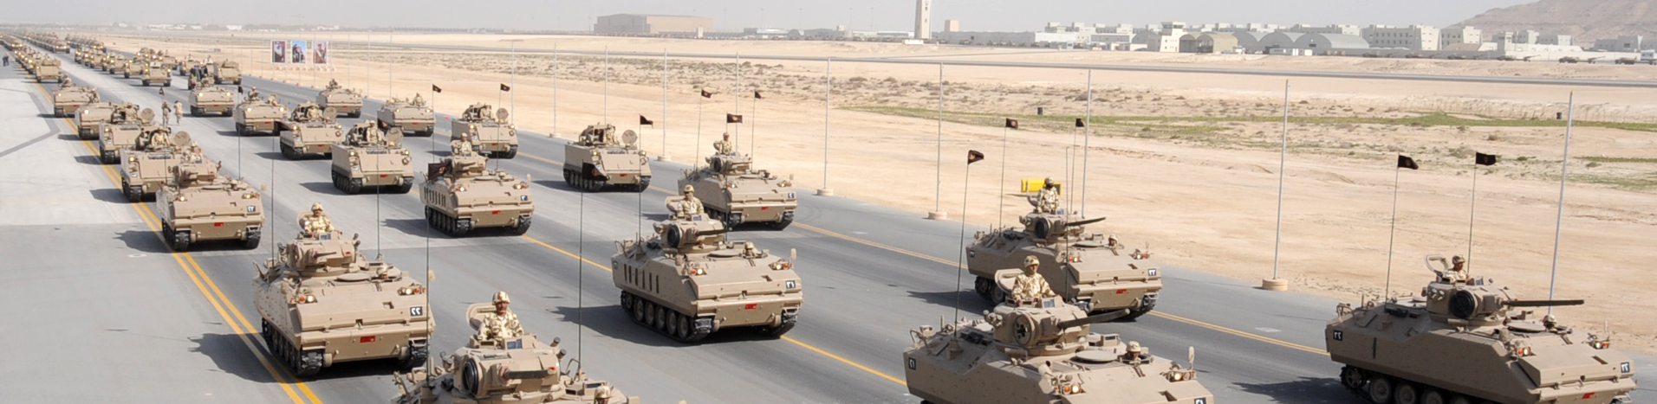
core - sets

Slide 43

core - settings

Slide 44
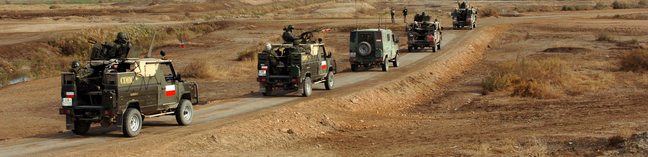
core - spawn

Slide 45

core - spawnstatic

Slide 46

core - spot

Slide 47
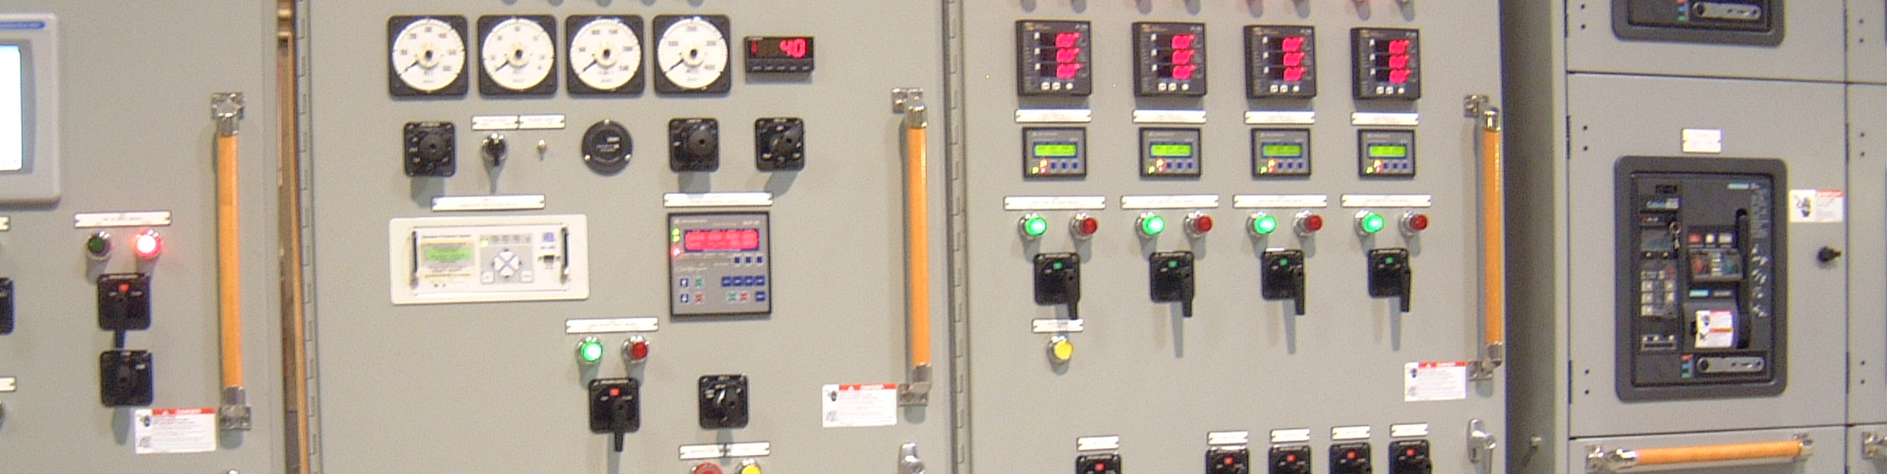
core - userflag

Slide 48
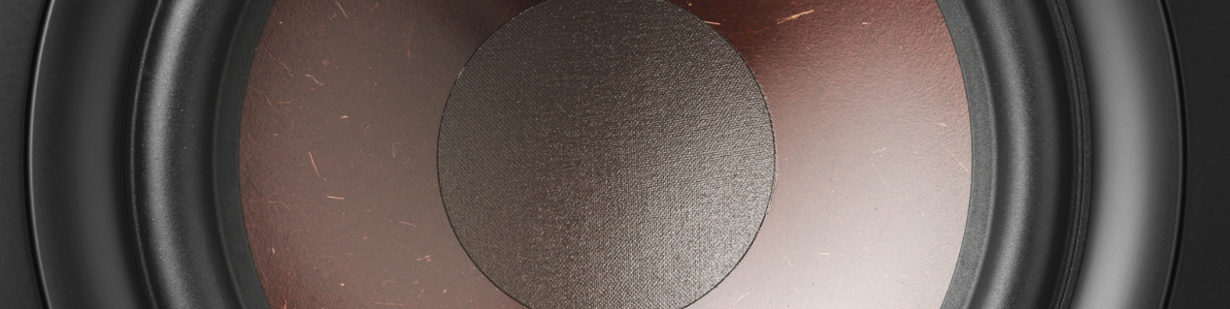
core - usersound

Slide 49
core - velocity

Slide 50
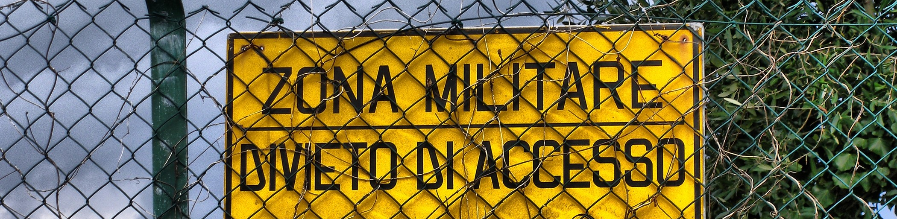
core - zones

Slide 51
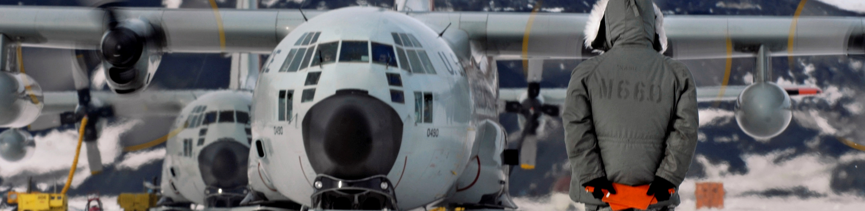
atc ground operations

Slide 52
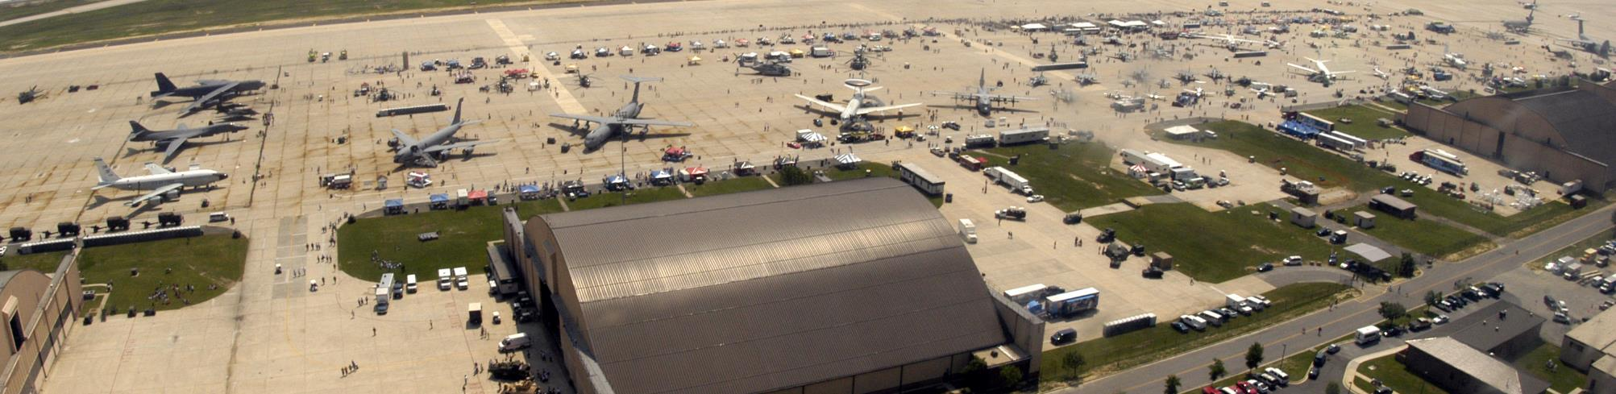
cleanup airbases

Slide 53

designation

Slide 54
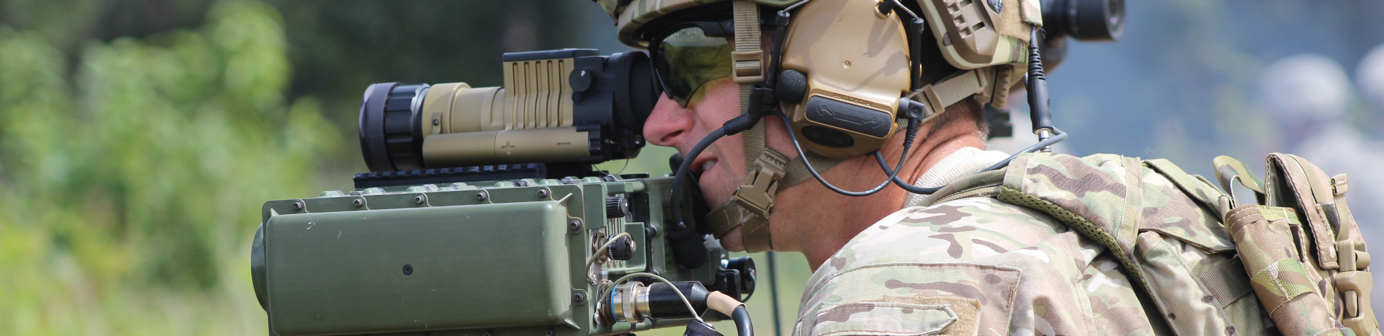
detection

Slide 55
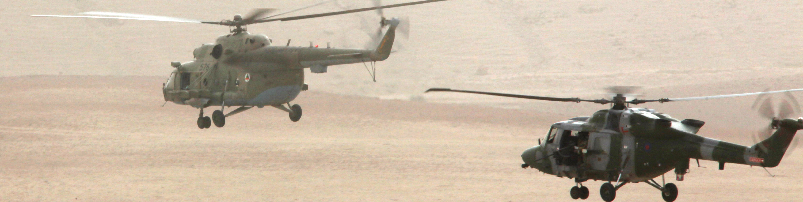
escorting

Slide 56
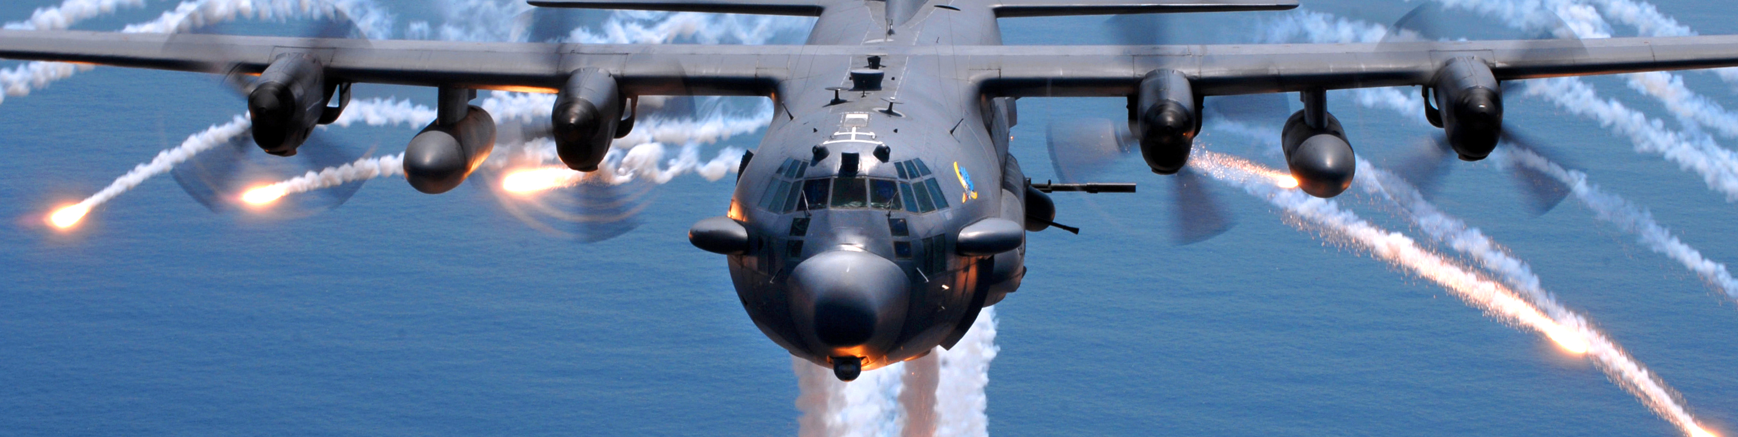
missile trainer

Slide 57
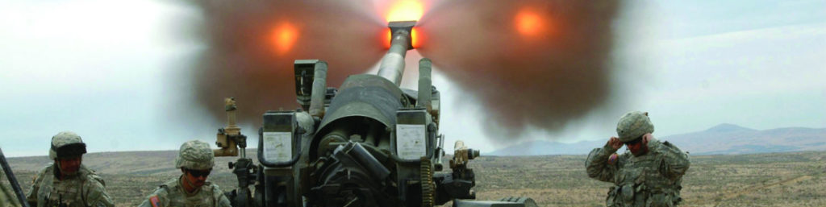
artillery

Slide 58
pseudo atc

Slide 59
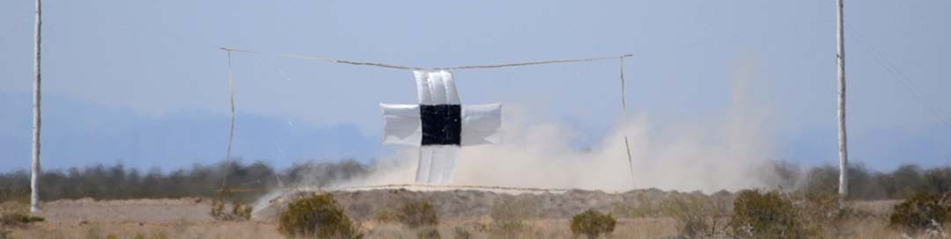
range

Slide 60
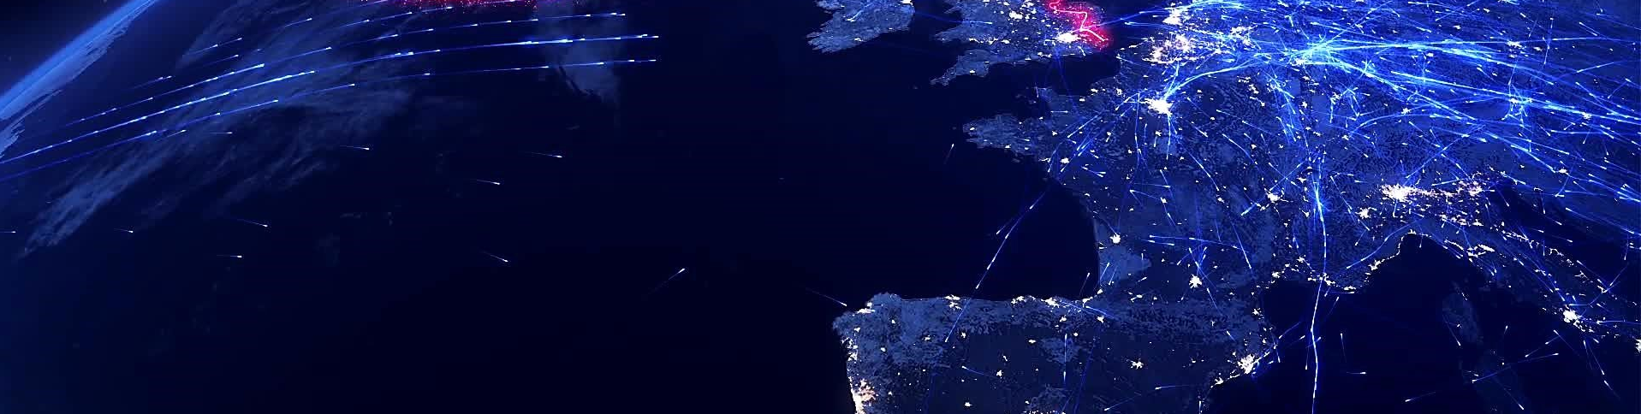
random air traffic

Slide 61
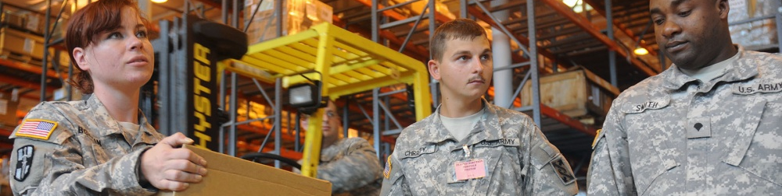
warehouse

Slide 62
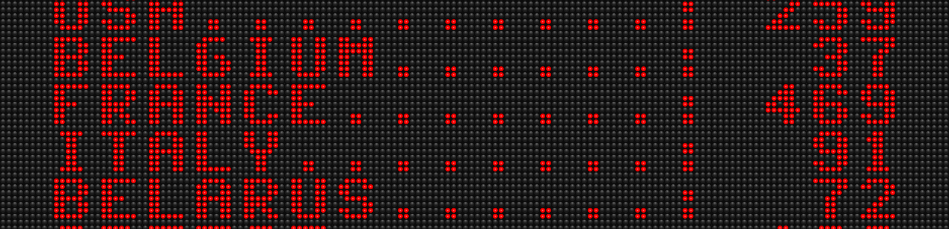
scoring

Slide 63
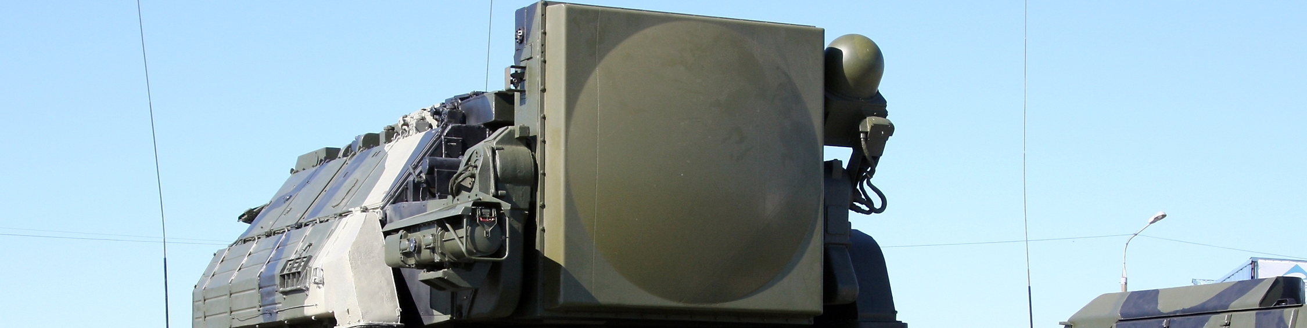
sead

Slide 64
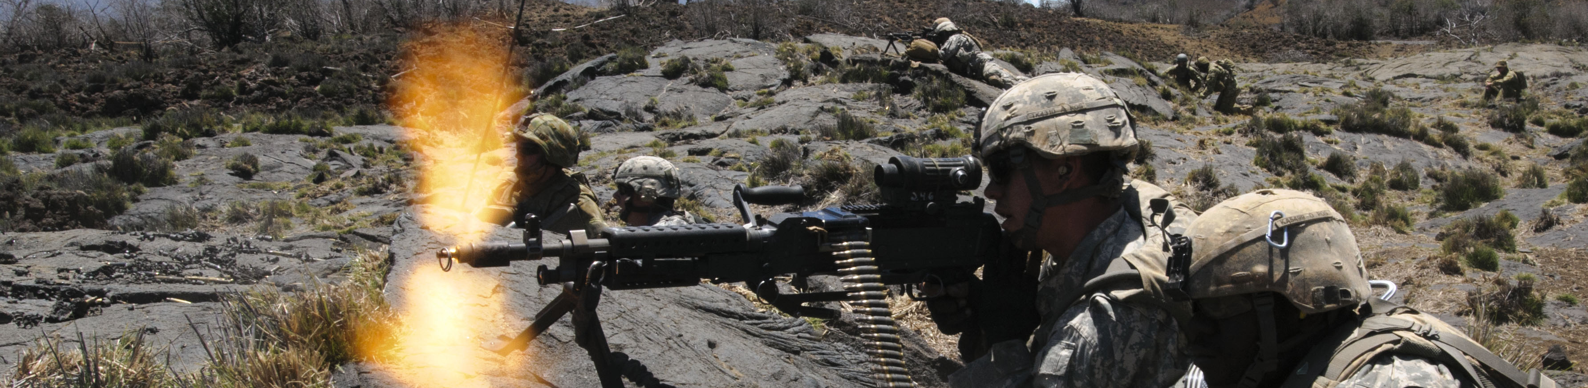
suppression

Slide 65

capture zones

Slide 66
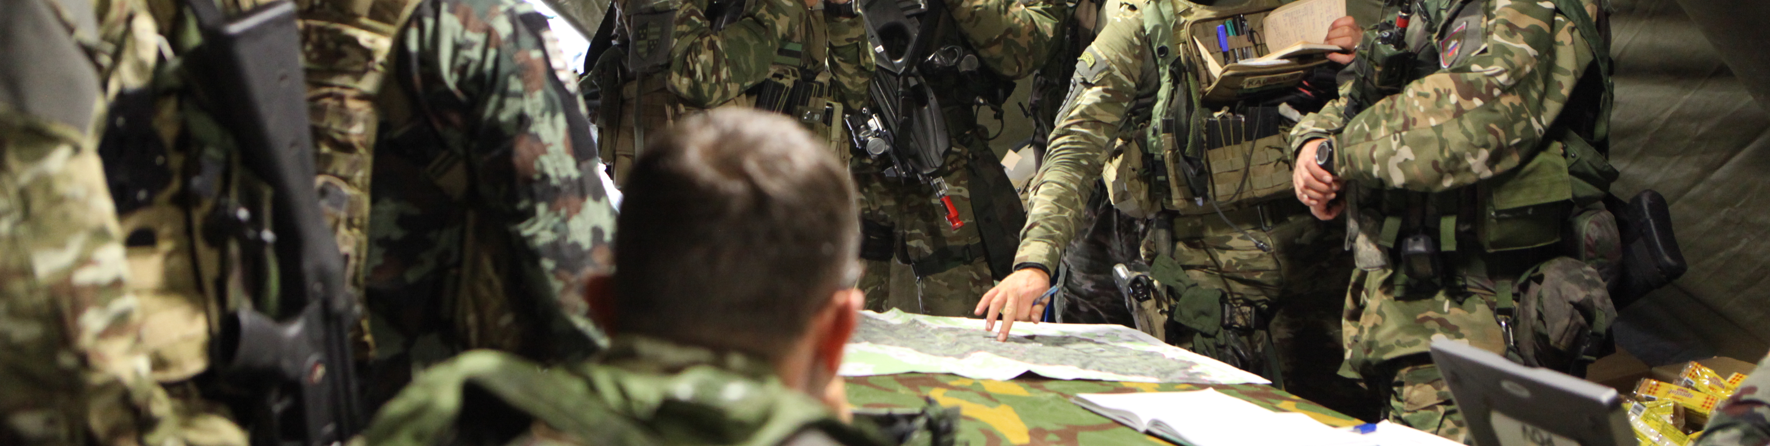
task - mission

Slide 67
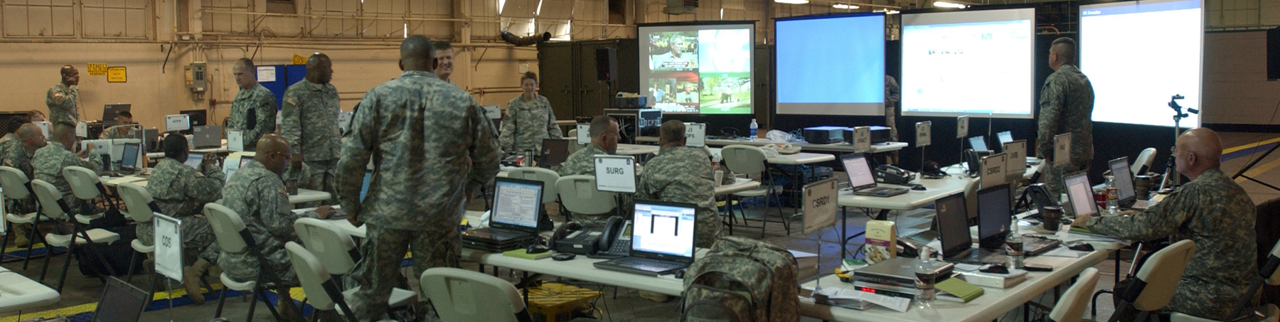
task - command center

Slide 68
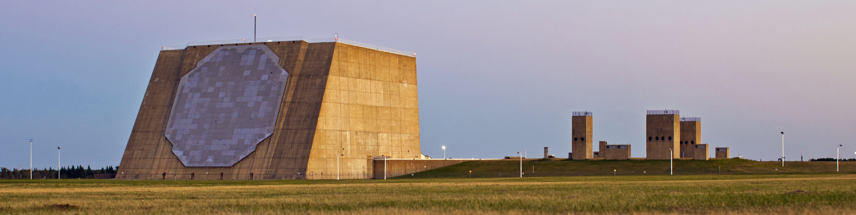
tasking - detection manager

Slide 69
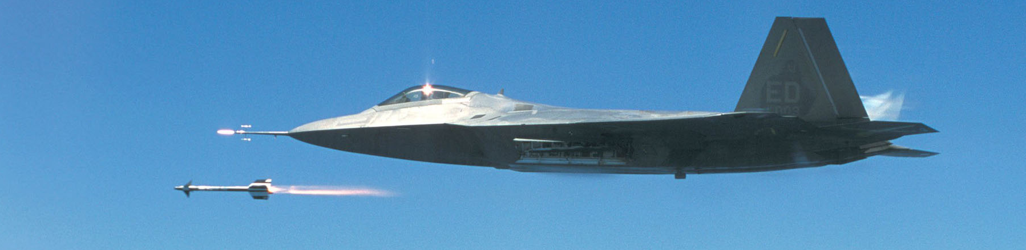
tasking - A2A task dispatcher

Slide 70
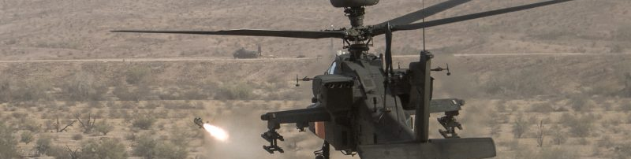
task - A2G dispatcher

Slide 71
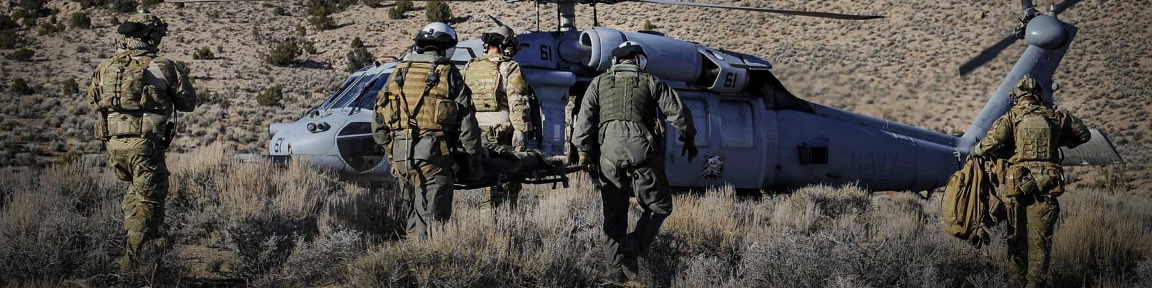
task - cargo csar

Slide 72
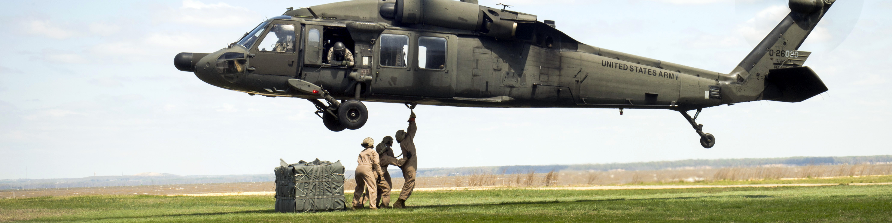
task - cargo transport

Slide 73
task - cargo dispatcher

Slide 74
task - cargo

Slide 75
task - manager

Slide 76
task - task

Slide 77
task - task info

Slide 78
task - task zone capture

Slide 79
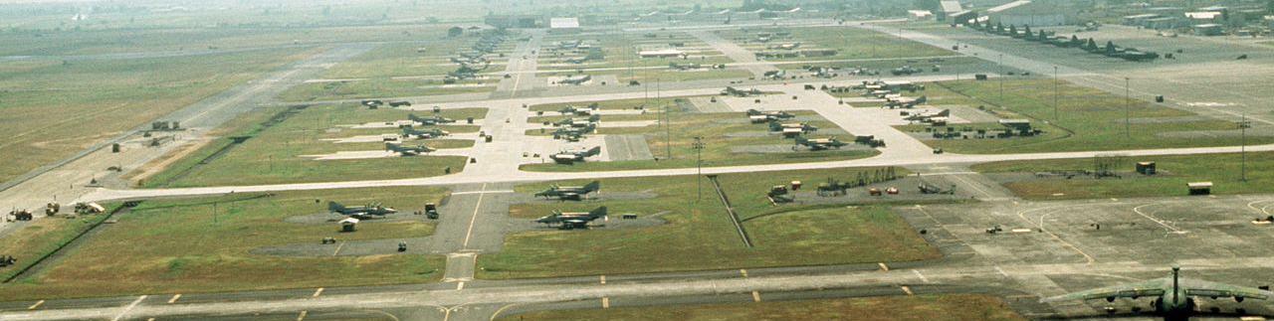
wrapper - airbase

Slide 80
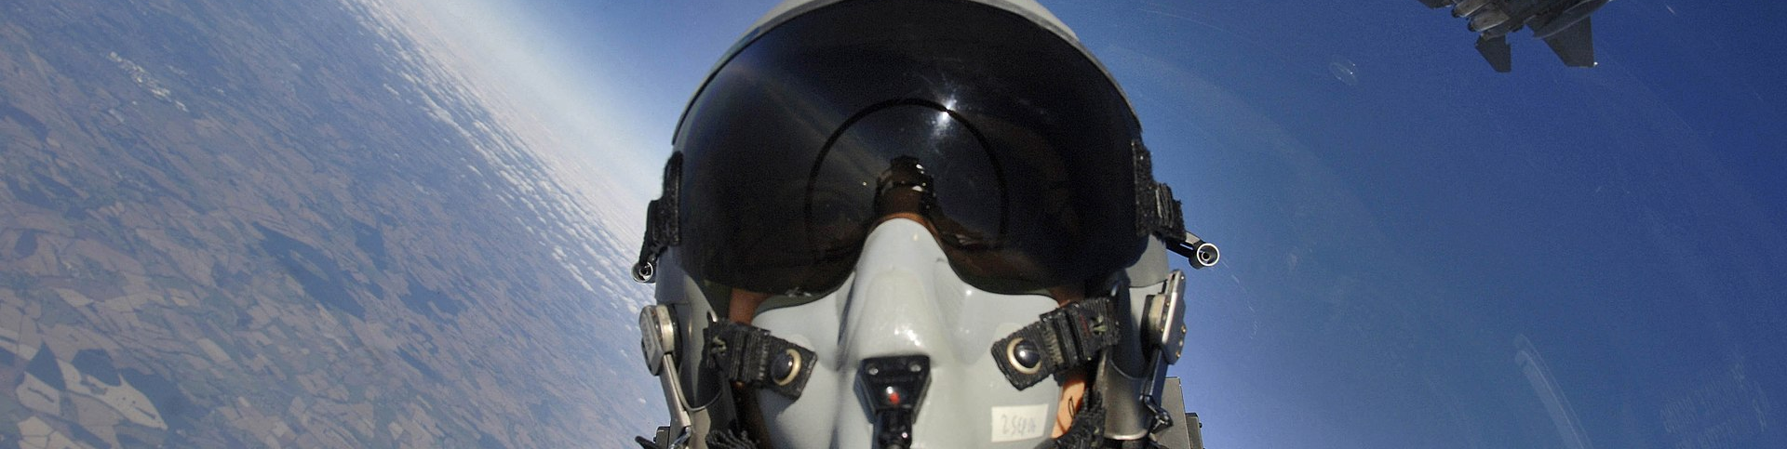
wrapper - client

Slide 81
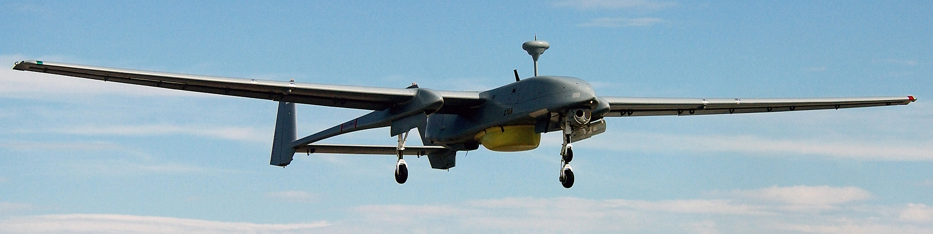
wrapper - controllable

Slide 82
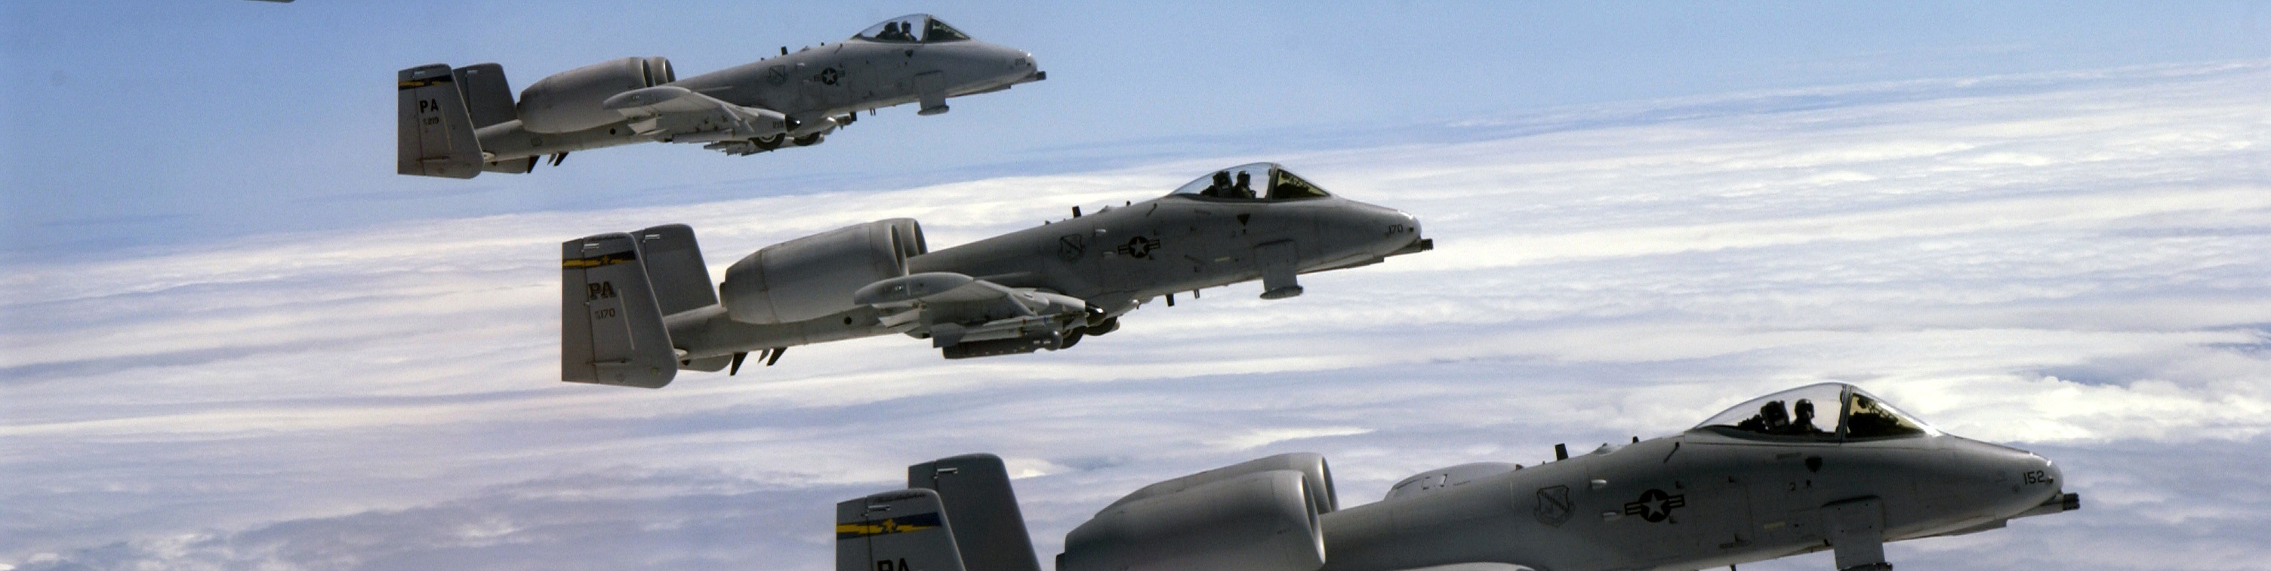
wrapper - group

Slide 83
wrapper - identifiable

Slide 84
wrapper - object

Slide 85
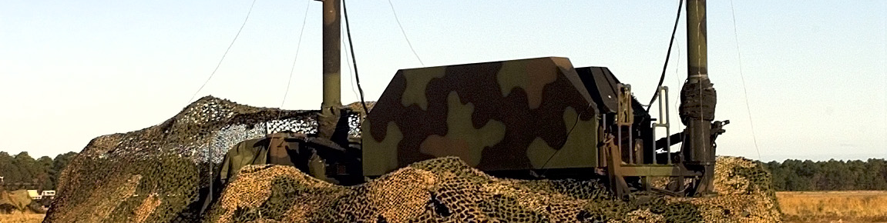
wrapper - positionable

Slide 86
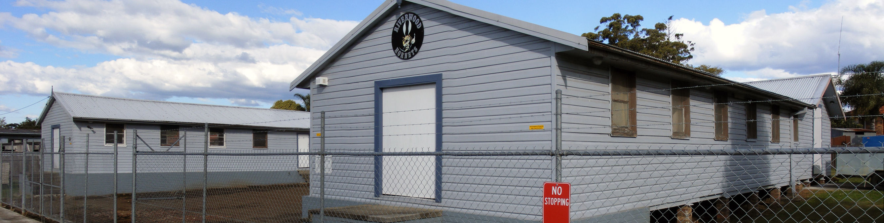
wrapper - scenery

Slide 87
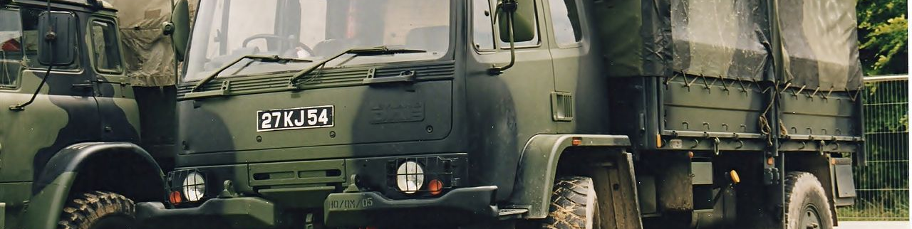
wrapper - static

Slide 88

wrapper - unit

